Slide 1
CONFERENCE PROJECT
Ground Effects & Free Wake Theory
Group 6
Apurva Kulkarni - 180010011
Nakul Rajesh Randad - 180010047
M Vishnu Sankar - 18B030013
Notes:
Hi everyone, we are from group 6 and we will get started with the presentation of the conference project and our topic is “Ground Effect” and “Free Wake Theory”

Slide 2
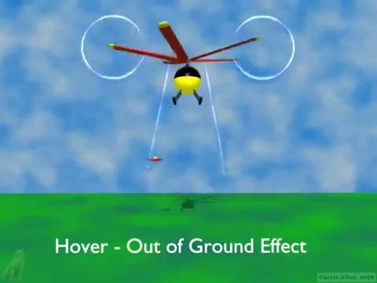
Ground Effects
Source [1]
Notes:
When a rotor hovers in close vicinity of the ground, the rotor slipstream rapidly expands as it approaches the surface and becomes parallel to it.
This change in geometry alters induced velocity in the plane of the rotor which in turn changes the thrust and power required to hover.
Due to this effect the thrust produced by the rotor blades IGE is more than the thrust at OGE for the same power.
the volume of air below rotor acts like a cushion
An intuitive way to understand this is the change in momentum in the vertical direction is much faster IGE as the overall structure changes as seen in the video. So thrust which is change in momentum per unit time is much higher in the vertical direction

Slide 3
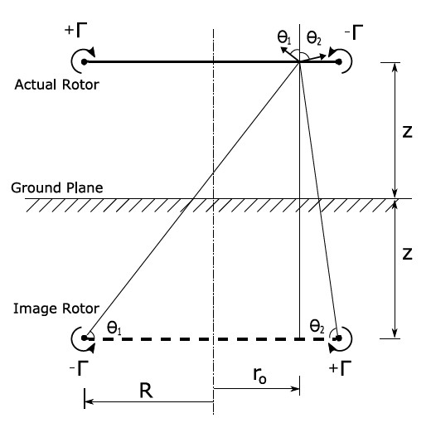
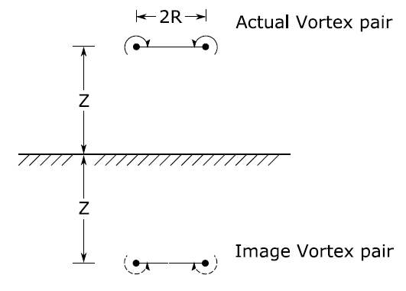
Methodology | Method of Images
Source [3]
Notes:
Modeling rotor and ground with method of images, instead of CFD
Concepts from classical potential theory is used
Rotor modelled using Pair of irrotational vortices rotating opposite
Ground is a zero flux plane, thus using an image pair of vortices. [go to ONENOTE]
At anypoint on the ground, the vertical velocities cancel and horizontal component adds up
Instead of using a high fidelity CFD tool, we use the concepts from the classical potential flow theory which assumes incompressible and irrotational flows for the modelling.
We model the rotor using a pair of irrotational vortices to simulate the inflow; and for ground (which is a zero flux surface), we exploit the “Method of Images”.
Assume that the ground is replaced by a mirror, so we get an image of rotor which has the opposite inflow. Now anypoint on the ground, the vertical velocities cancel out.

Slide 4
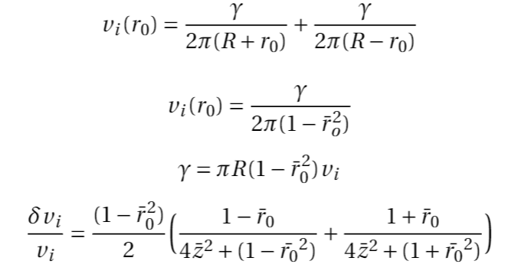
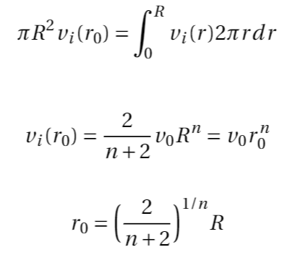
Method of Images | Assumptions
Constant Power at all heights
Ground plane modelled as an infinite plane
Uniform velocity distribution
Only tip vortices considered
v(r) is a polynomial function of r
Notes:
We assume that the power is const at all heights which implies that the velocity has to reduce as the thrust has increased.
Only tip vortices considered as they are the major contributing factors
To find the strength of the tip vortices we assume that the velocity at a reference location r0 is constant across the rotor disk. [go to eqn 1 in RHS]. Flux of this model and real rotor are equated to get a relation between radius of blade and r0 as
the induced velocity In the rotor disk is a polynomial function of radius with exponent n. This gives the vorticity value. When this value is directly substituted in the thrust equation we get an expression only in terms of n. For value of n between 2 and 4 decent results are obtained, and for n=3.84 as prescribed by a paper very good results can be obtained, so the solution space of induced velocity is not restricted just to polynomial function.

Slide 5
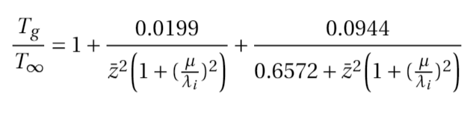
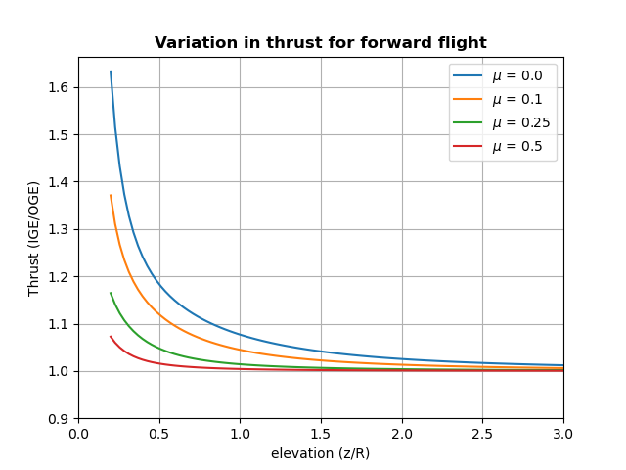
Ground Effect on Forward Flight
Notes:
This is the final expression with n=3.84. Z_bar is non-dim elevation
Thrust ratio is ratio of thrust IGE to OGE
Here we infer two phenomenon.
After about 2 times the radius elevation the ground effect is very small and can be neglected ie GE vanishes rapidly as elevation increases.
2nd is
For hovering condition (advance ratio is 0) the thrust ratio is the higher than forward flight conditions. This because in forward flight the cushioning effect decreases as the wake of air is not present directly below the rotor and is trailing behind it.
So as the forward velocity increases, GE decreases and so thrust ratio decreases.

Slide 6

Rotor Simulation
Notes:
Free wake theory accounts for the induced velocity due to all the vortex filaments on one another. Vortex segments allowed to get influenced by velocities induced by other segments and move freely in space. And the wake shape is updated at each time step
In the video: The blue color thing, is the visualization of the vortex filaments.

Slide 7
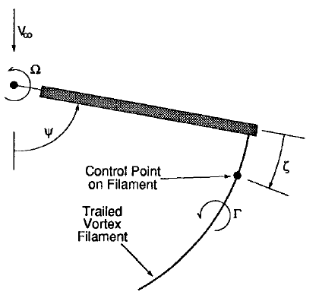
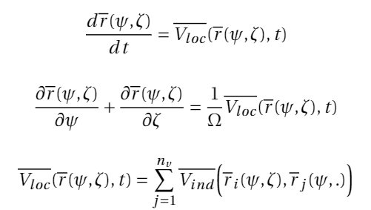
Free Wake Theory
Notes:
THe governing equation simply states that the evolution of time of a position vector is the velocity vector of the filament. The velocity of a filament is same as the net induced velocity due to other filaments on that particular filament. // Explain Phi and Zeta and omega Bio Savart Law. nv is number of blades

Slide 8
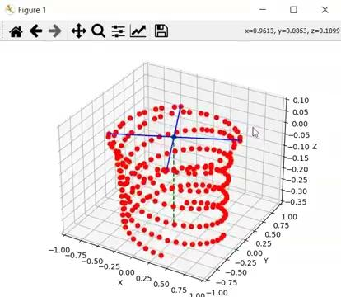
Prescribed Wake Model
Modification After Submission

Slide 9
Free Wake Theory | Methodology
Initial Condition - Prescribed Wake Model
Vortex filaments
Iterations in time
Bio-Savart’s law to account induced velocity
New vortex filament formed
Remove the last filament
New wake geometry
Loop until geometry converges
Notes:
Just the discretization, How we are using evaluation of previous iterations for the next iterations
As a Initial Condition we assume Prescribed Wake Model, the blade rotates about 20 degrees every time steps. And at each time step we calculate the induced velocities at every new filament and get a new wake geometry, each iteration consists of a certain number of time steps. After every iteration the previous geometry is compared with the new geometry, if the error in the position is smaller than a tolerance value then convergence is achieved.

Slide 10
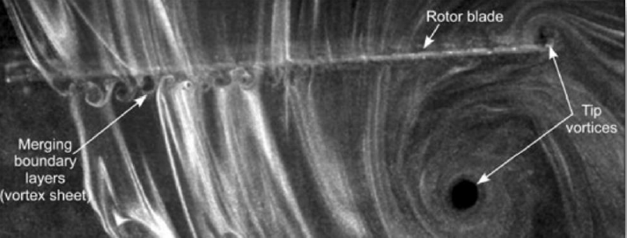
Free Wake Theory | Assumptions
Incompressible and irrotational flow
Only tip vortices are considered
Inboard vortex filaments have insignificant influence
Tip vortices 80% that of maximum bound vortex
Viscous dissipation are ignored
Notes:
In the previous slide we did not mention how we are getting the value of vorticity of the vortex filaments. This is obtained from the BEMT, we get radial lift distribution, then we use Kutta-Joukowski theorem i.e Lift = density * velocity * circulation. So K-J theorem assumes incompressible and irrotational flow. THen tip vortices are assumed to be 80% as strong as the maximum bound vortex. Inboard vortex filaments have very small influence, so they are being neglected in the simulation, and viscous dissipation is ignored.

Slide 11
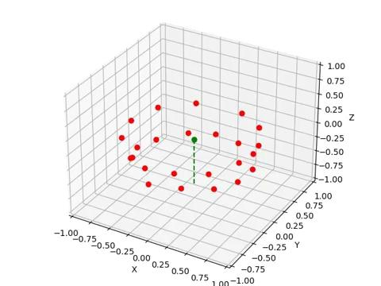
Free Wake Theory | Results
Without Ground Effect
Modification After Submission
Notes:
Some important details which we didn’t delve much into the PPT is the hybrid implicit/explicit scheme that we used in the algorithm. This method is reliable and accurate, but sometimes convergence may not be reached at all.

Slide 12
Results | Ground Effect & Free Wake Theory
With Ground Effect
Modification After Submission

Slide 13
References
Ground Effect
ONERA
Cibin Joseph and RanjithMohan, "A New Ground Effect Factor based on Image Vortices",
2017, Research Gate
G.L. Crouse, Jr. and J.G. Leishman, "A New Method for Improved Rotor Free-Wake Convergence", AIAA 93-0872, 31st Aerospace SciencesMeeting Exhibit, January 1993
Modification After Submission

Slide 14
Thank You
Drive link for all the code is here

Slide 15
Questions
Which of the assumptions are true for Free Wake Model?
Incompressibility
Irrotationality
Incompressibility and Irrotationality
Incompressible and rotationality
At a constant height from the ground as the forward speed increase the thrust due to ground effect
Decreases
Increases
First decreases and then increases
First increases and then decreases
In the free wake theory only the tip vortices are assumed to influence the wake geometry because
Only tip vortices are formed in reality
Tip vortices have strongest circulation than any other vortex filaments
Inboard vortex filaments are weak and hence have insignificant influence on the wake geometry
The assumption is wrong and cannot yield reliable results

Slide 16
Questions
Ground effect is modelled using
Pair of source and its images
Pair of sink and its images
Pair of vortex and its images
Pair of vortex and a free stream
In the equation shown induced velocities are computed using
Kutta-Joukowski theorem
Bio-Savart Law
Lifting line theory
Thin airfoil theory

